Slide 1

Capstone Project:
Traffic Crashes in Chicago
Group 5:
Min-Chi Tsai
Fatima Nurmakhamadova
Prof. Daya Rudhramoorthi ALY 6140 - 80784
Analytics Systems Technology
College of Professional Study
May 17, 2022
Welcome

Slide 2
AGENDA
Project Introduction
Exploratory Data Analysis (EDA)
Modeling
Conclusion & Recommendations

Slide 3
Introduction
The goal of the project is to help Chicago Police Department to
predict the traffic crash type, and
understand the causes that lead to it.
The data set is about daily traffic crash reports in Chicago city from 2015 to the present provided by Chicago Police Department.
Questions we want to solve
What factors affect the severity of the traffic crash?
What are the common types of traffic crashes and their causes?
How environmental factors affect crashes?
What time of the day has the most traffic crashes?

Slide 4
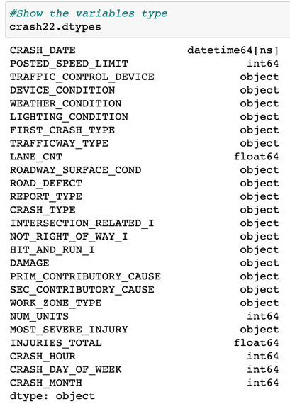
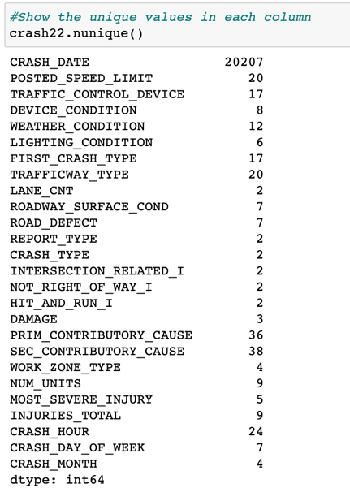
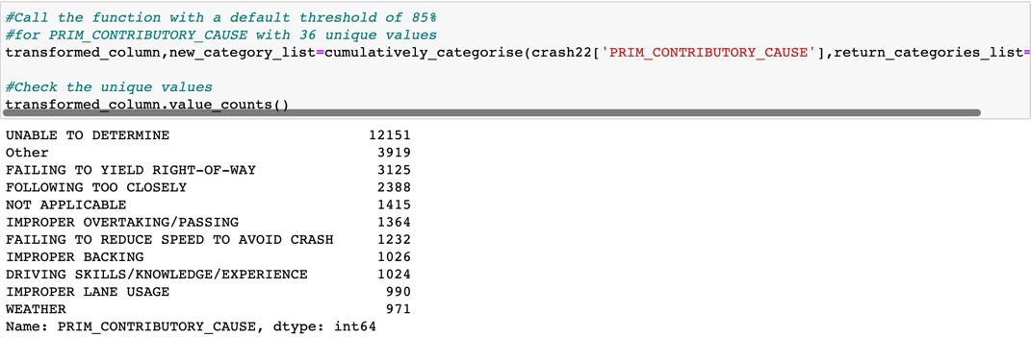
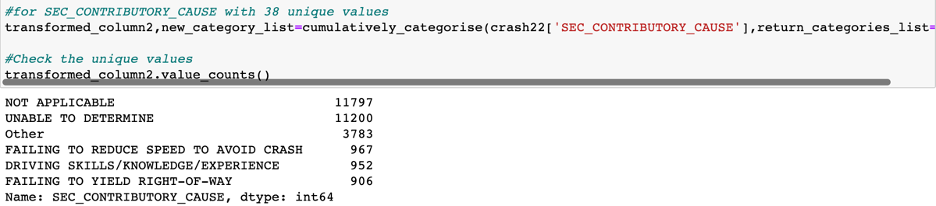
EDA: Data Cleaning
Checking the wrong data types
The initial dataset consists of
605,121 records, and 49 features
Our focus on 2022
29,605 records, and 26 features
19 categorical, 7 numerical variables
Feature Engineering: reduce the cardinality
from 36 to 11 in the PRIM_CONTRIBUTORY_CAUSE
from 38 to 6 in the SEC_CONTRIBUTORY_CAUSE
Crash Type is a target variable
0 - no injury / drive away
1 - injury and / or tow due to crash

Slide 5
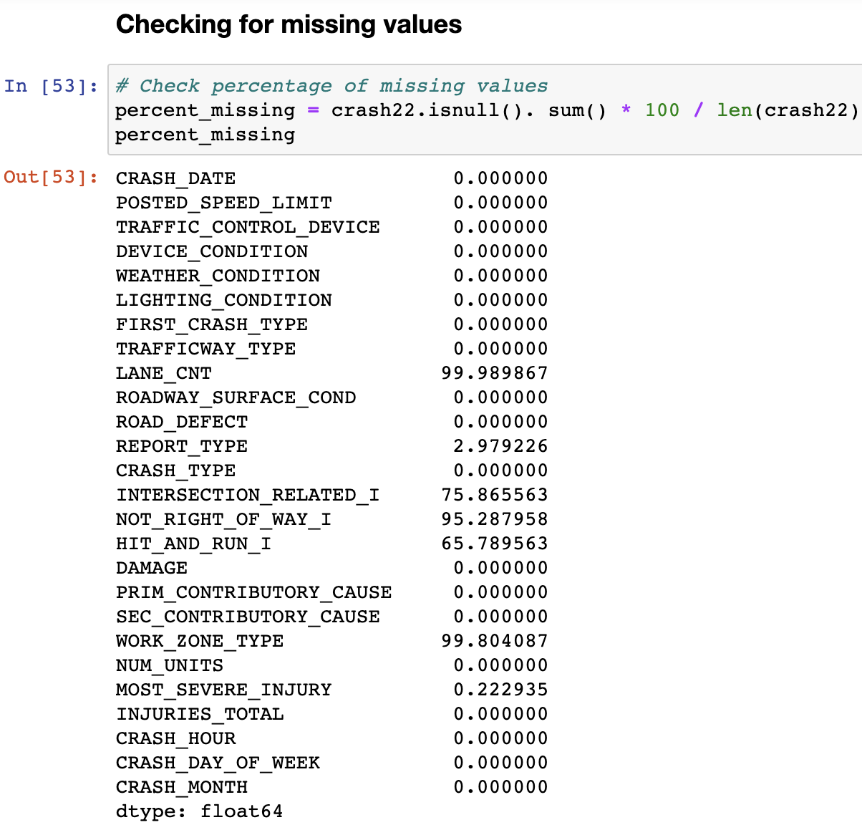
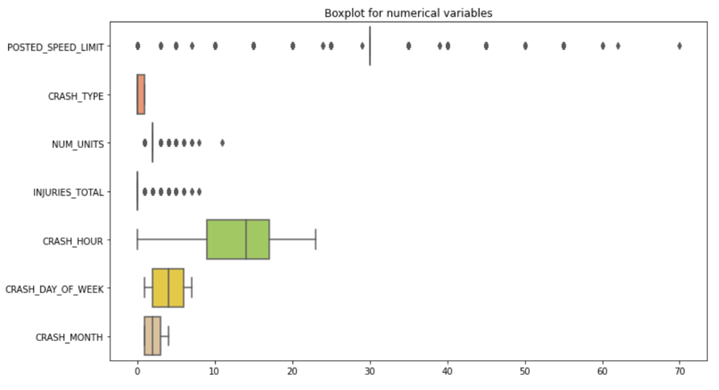
EDA: Data Cleaning
Missing values
Deleting 5 columns – with more than 50%
Drop rows – with less than 3%
Outliers
3 columns with outliers
Removed only single outlier values
Keep the rest outliers
The dataset shape now is 28,653 rows and 21 columns

Slide 6
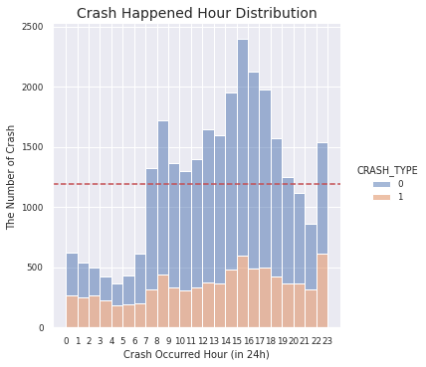
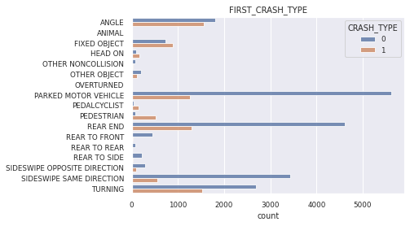
EDA: Data Visualization
Q: What time of the day has the most traffic crashes?
Q: What are the common types of traffic crashes and their causes?
Most crashes: 2 - 3 pm
Serious crashes: 3 – 4 pm & 10 -11 pm
Most of injury crashes: Angle & Turning
Injury > No Injury: Pedestrian, Fixed Object

Slide 7
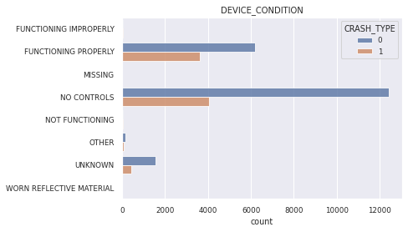
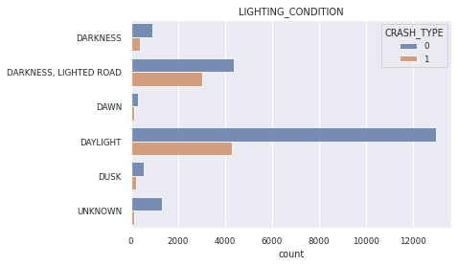
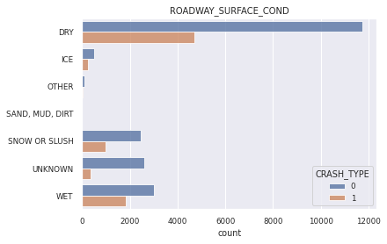
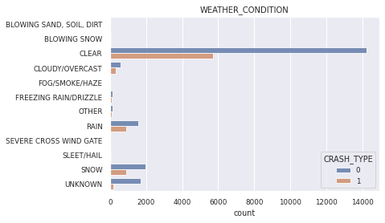
EDA: Data Visualization
Q: How environmental factors affect crashes?

Slide 8
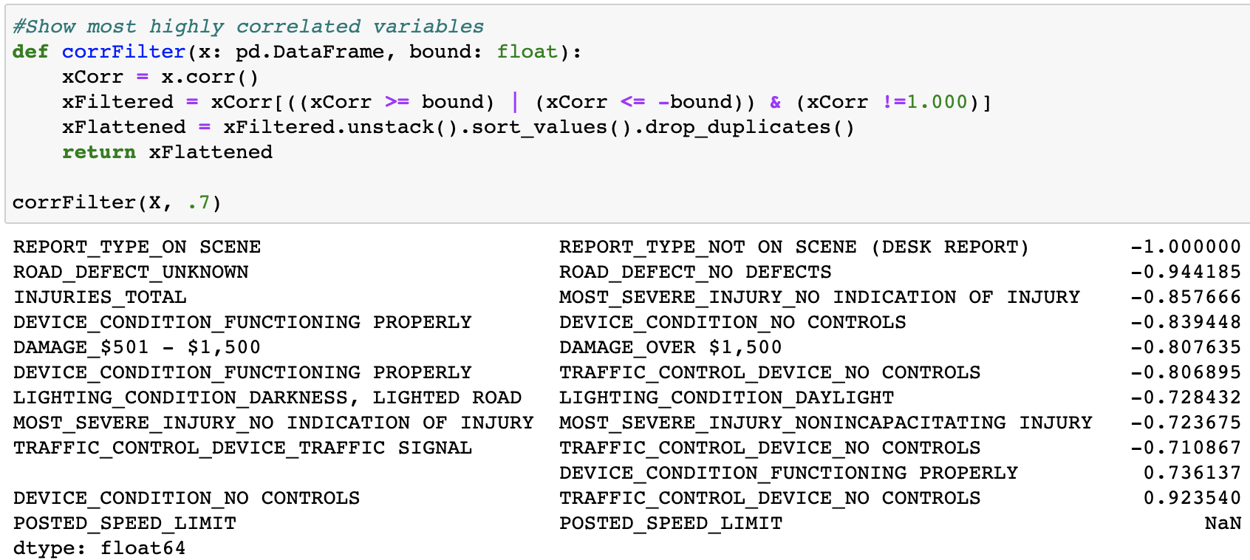
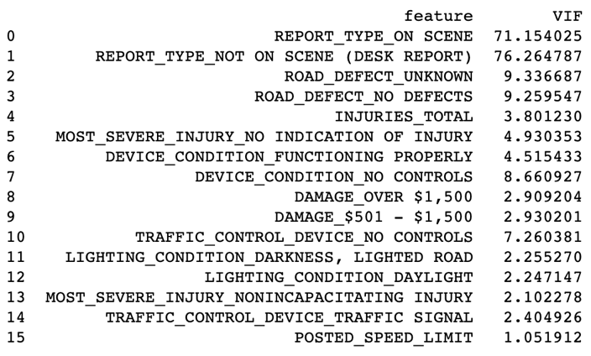
Modeling – Data Preparation
Assigning features (X) and target variable (y)
Encoding Categorical Variables (Dummy)
Checking for multicollinearity
Correlation matrix ≥ +- 0.7
VIF score ≥ 7
6 columns with high correlation
Split Data
Training and Testing (70/30)
Train set - 20,057 rows, and 121 columns
Test set has 8,596 rows and 121 columns

Slide 9
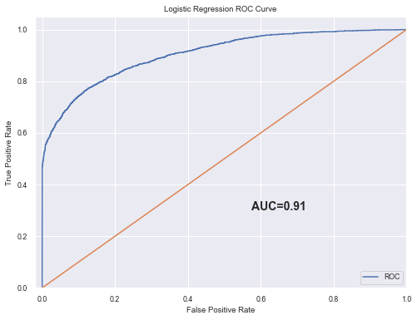
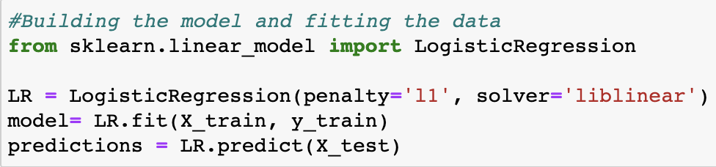
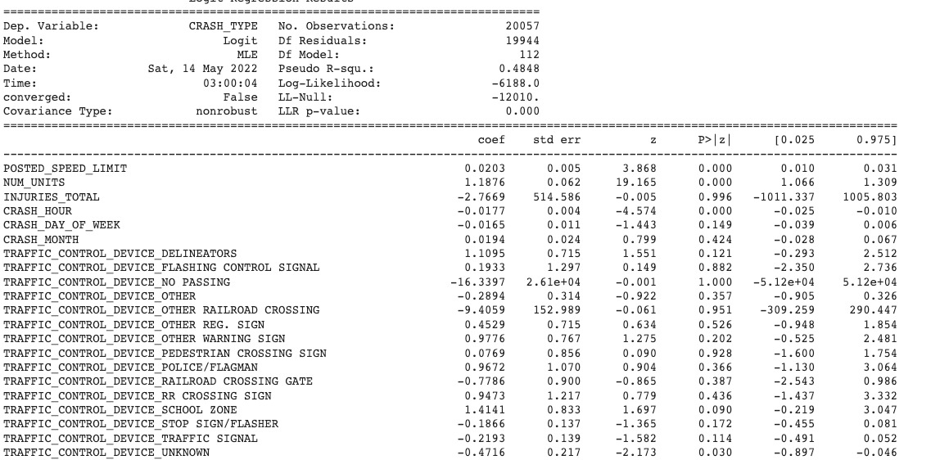
Modeling – Logistic Regression
Accuracy: 0.87
L1 regularization for optimization
ROC curve - the summary of classifier performance
AUC is 91%
Summary
Most significant variables with the p-value below the alpha level is 0.1
5 significant variables with p-value <0.1

Slide 10
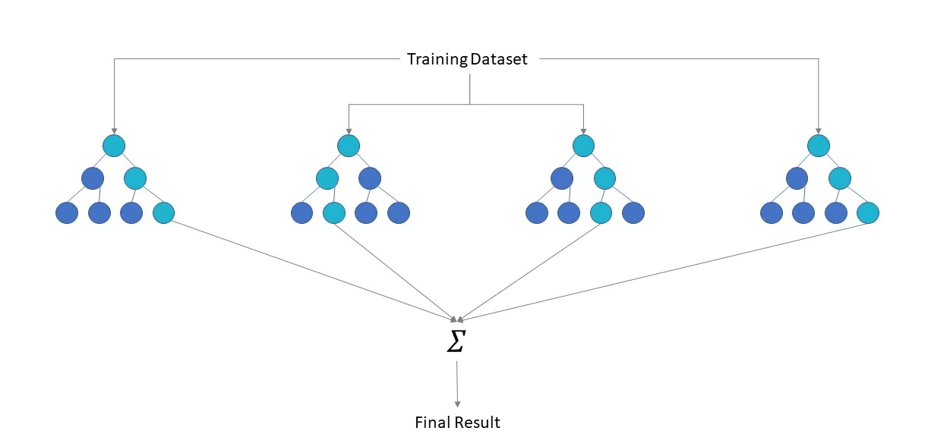
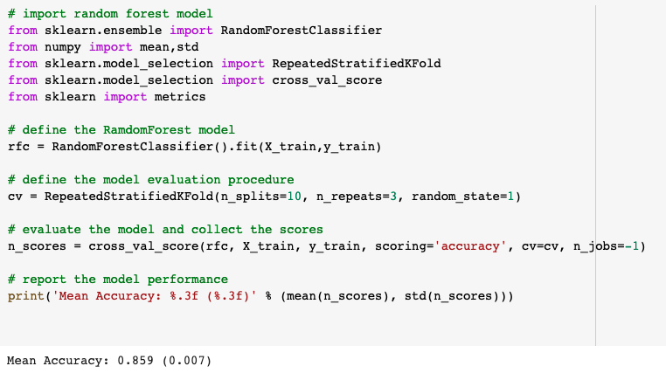
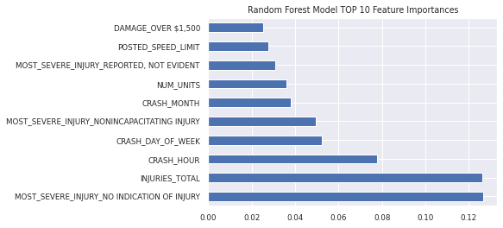
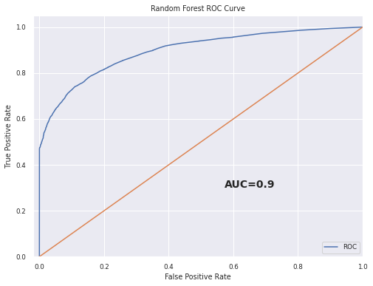
Modeling – Random Forest
Accuracy: 0.86

Slide 11
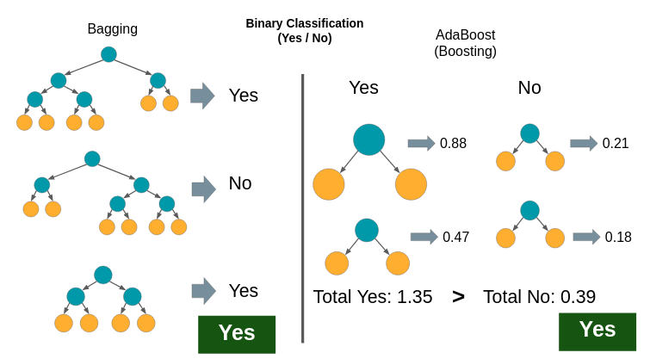
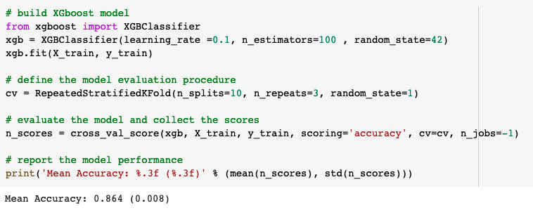
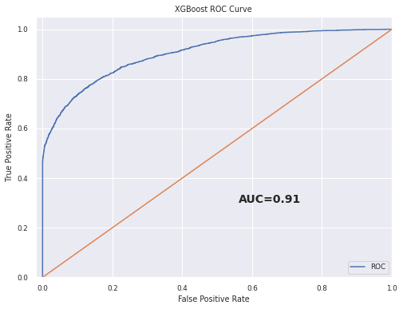
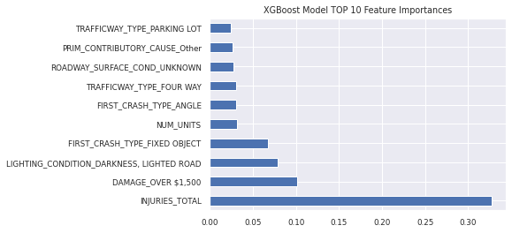
Modeling – XGBoost
Accuracy: 0.87

Slide 12
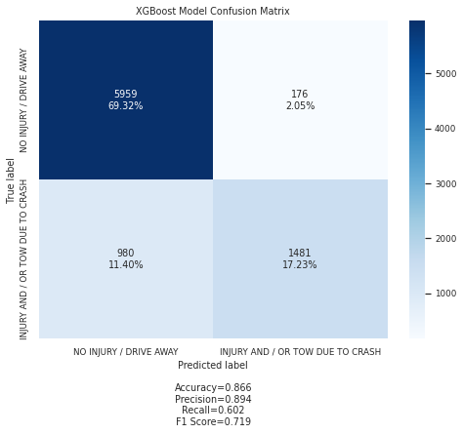


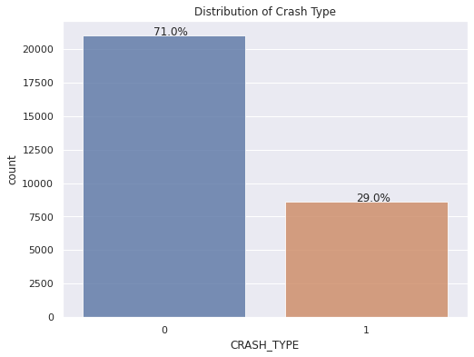
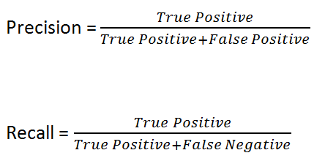
FP & FN -
Model Comparison
TP & TN -
XGBoost model - most True Negatives, and least False Positives
Logistic Regression model - most True Positives, and least False Negatives
recall values -> imbalance between classes

Slide 13
Conclusion & Recommendations
Q: What factors affect the severity of the traffic crash?
CRASH_HOUR
Most crashes that involves any injury or vehicle tow is caused during the high traffic peak from 7 to 9 am and 3 to 6 pm.
NUM_UNITS
The probability of getting injury rises if the crash involves more than 1 unit whether it is a vehicle, pedestrian, or bicyclist.
POSTED_SPEED_LIMIT
The rising posted speed limit also might affect the crash severity.
We would recommend the city of Chicago to pay more attention and take the necessary precautions during the peak hours and try to reduce the traffic.

Slide 14
Q & A
Thank You

Slide 15
Reference
Chen, & Guestrin, C. (2016). XGBoost: A Scalable Tree Boosting System. Proceedings of the 22nd ACM SIGKDD International Conference on Knowledge Discovery and Data Mining, 785–794. https://doi.org/10.1145/2939672.2939785
Levy , J. (2022, April 20). Traffic crashes - crashes: City of chicago: Data Portal. Chicago Data Portal. Retrieved April 21, 2022, from https://data.cityofchicago.org/Transportation/Traffic-Crashes-Crashes/85ca-t3if?category=Transportation&view_name=Traffic-Crashes-Crashes
Sangani, R. (2021, August 11). Dealing with features that have high cardinality. Medium. Retrieved May 15, 2022, from https://towardsdatascience.com/dealing-with-features-that-have-high-cardinality-1c9212d7ff1b

